Slide 1
Part 2
Business information
systems development
Chapter 7
An introduction to acquiring
and developing BIS

Slide 2
Learning objectives
After this lecture, you will be able to:
  evaluate the different alternatives for acquiring BIS;
  distinguish between the typical stages involved in building BIS;
  explain the purpose of each stage in building a system;
  select the best alternative type of approach or methodology for building a BIS.

Slide 3
Management issues
From a managerial perspective, this lecture addresses the following areas:
What are the alternatives for systems acquisition and how is the most suitable approach selected?
What alternative models are there for the different stages for introducing a BIS? Which is most appropriate?
Which activities need to occur at each stage for the project to be successful?

Slide 4
Introducing BIS acquisition
BIS acquisition: The process of evaluating and implementation for a BIS.
Systems development lifecycle (SDLC): Any information systems project follows a logical series
of development phases. These are known as the systems development lifecycle.
SDLC stages: Initiation, feasibility study, analysis of business requirements, systems design, system build and implementation and, finally, review and maintenance.

Slide 5
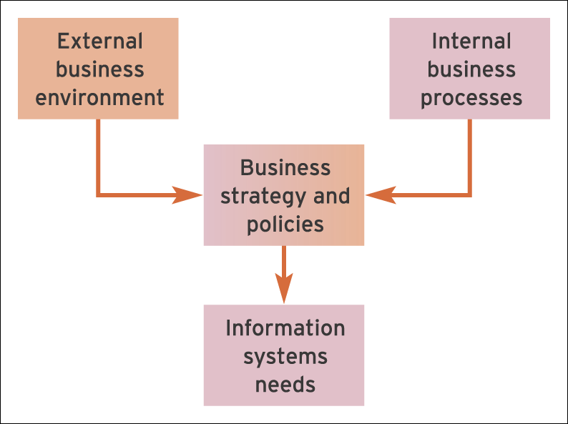
Figure 7.1 Drivers for information systems aquisition

Slide 6
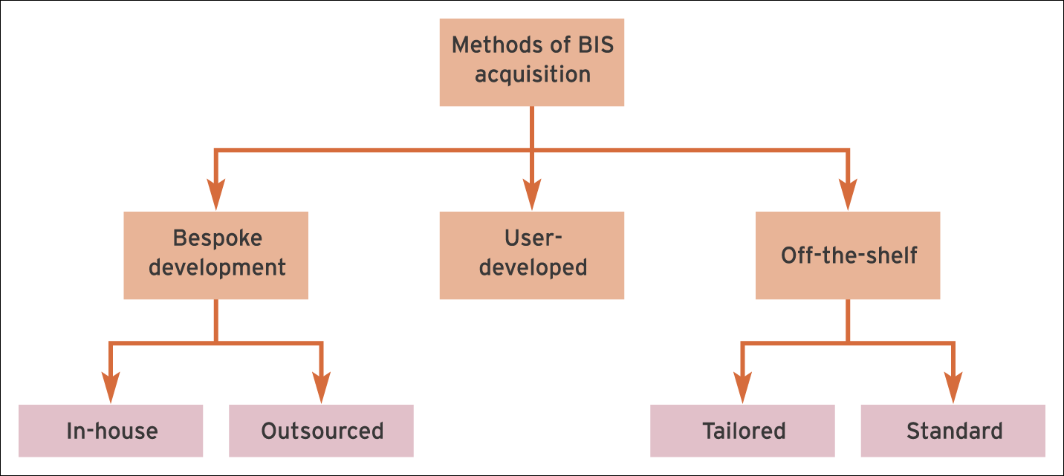
Figure 7.2 An example of a typical evaluation of alternatives for BIS acquisition

Slide 7
1. Bespoke development
Bespoke development: An IS is developed ‘from scratch’ by an IS professional to suit the business requirements of the application.
Benefits:
  Tailored to requirements of business
  May confer specific competitive advantage.
Problems:
  Expense – Most expensive way of developing a new information system
  Time – Development is often delayed
  Quality – Software code may contains bugs.

Slide 8
2. Off-the-shelf purchase
Off-the-shelf purchase: An acquisition method that involves direct purchase of a pre-written application used by more than one company.
Benefits:
  Time – Quick purchase
  Cost – Low cost due to economies of scale
  Quality – Should offer stability and be feature-rich.
Disbenefits:
  May omit some features specifically required by individual customer
  Requires changes to process to meet needs of software.

Slide 9
2. Off-the-shelf purchase (Continued)
A tailored off-the-shelf purchase is an off-the-shelf purchase that has specific programming development or extensive configuration tailored to the needs of the customer.
A component off-the-shelf purchase is an off-the-shelf purchase that can be configured using
pre-written modules.

Slide 10
3. End-user-developed software
End-user-developed software: Software written by non-IS professionals, i.e. the business users.
Benefits:
  Tailored to the needs of end-users
  Often relatively fast.
Problems:
  May not achieve wider business objectives
  Quality may be a problem when written by non-IS professional. Maintenance may be difficult.

Slide 11
Other factors affecting selection
Size of the organisation
Size of in-house IT capability
Complexity of information system (are there special issues for the market the company operates in)
End-user experiences
Linkages to other applications/data sources.

Slide 12
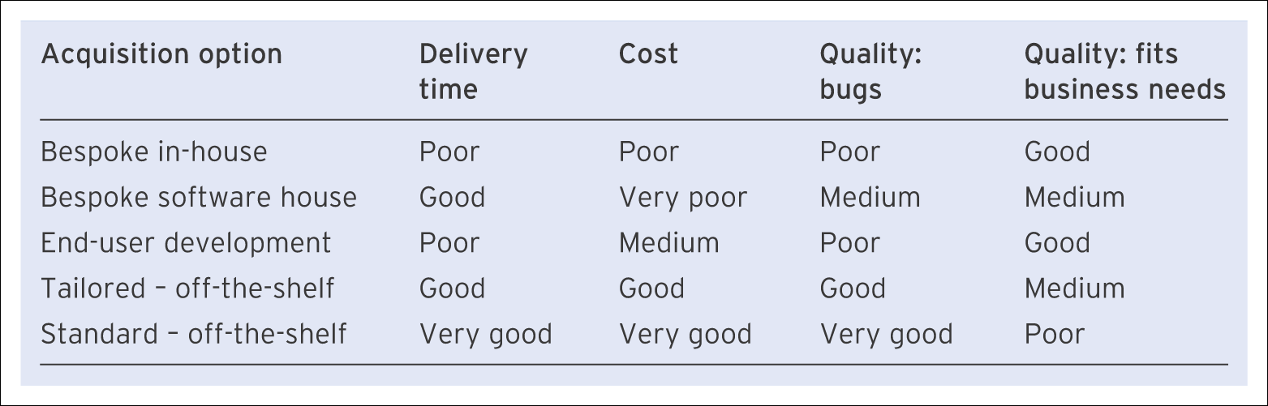
Summary – acquisition alternatives
Table 7.1 An evaluation of alternatives for BIS acquisition

Slide 13
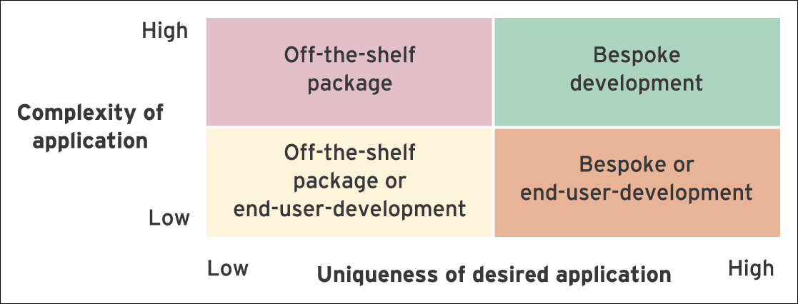
Figure 7.3 Application complexity versus uniqueness

Slide 14
Software acquisition and the systems development lifecycle
The systems development lifecycle (SDLC) model was developed and launched by the National Computing Centre in the UK in 1969. The SDLC approach recognises that systems are developed in a series of steps or phases and that each phase needs to be completed before the next one commences.
Recognition is also given to the fact that the programming activity (part of the build phase) should only commence once user requirements have been determined and the system design produced. Figure 7.4 illustrates the normal steps found in the systems development lifecycle.

Slide 15
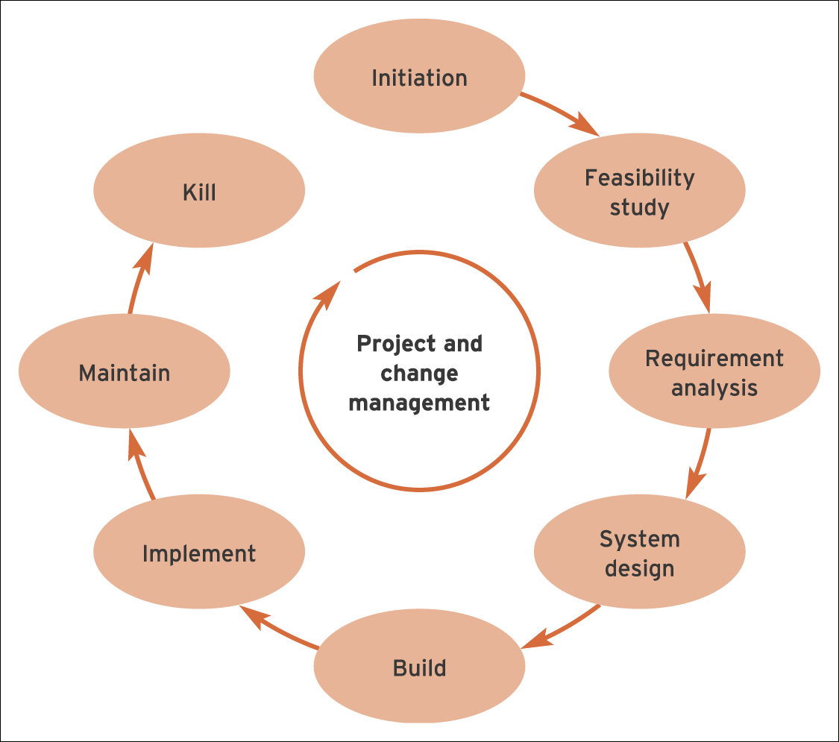
Figure 7.4 The systems development lifecycle (SDLC)

Slide 16
Initiation phase
Initiation phase:
  The startup phase in an IS development project. Its aims are to establish whether the project is feasible and then prepare to ensure the project is successful.
Initiation phase context:
  Input: creative thought and/or systematic evaluation of IS needs.
  Output: idea for initiation of a new information system.

Slide 17
Feasibility assessment
Feasibility assessment: An activity at the start of a project to ensure that the project is a viable business proposition. The feasibility report analyses the need for and impact of the system and considers different alternatives for acquiring software.
Feasibility assessment context:
  Input: idea for initiation of a new information system.
  Output: feasibility report and recommendation to proceed.

Slide 18
Systems analysis
Systems analysis: The capture of the business requirements of a system from talking to or observing end-users and using other information sources such as existing system documentation. Defines what the system will do.
Systems analysis context:
  Input: terms of reference in feasibility report describing outline requirements.
  Output: detailed requirements specification summarising system functions. Supported by diagrams showing the information flow and
  processes that are required.

Slide 19
Systems design
Systems design: Defines how the system will work in key areas of user interface, program modules, security and database structure and transactions.
Systems design context:
  Input: requirements specification.
  Output: detailed design specification.

Slide 20
System build
System build: Describes the creation of software by programmers. It involves writing the software code (programming), building release versions of the software, constructing and populating the database and testing by programmers and end-users. Writing of documentation and training may also occur at this stage.
System build context:
  Input: requirements and design specification.
  Output: working software, user guides and system documentation.

Slide 21
System implementation
System implementation: Involves the transition or changeover from the old system to the new and the preparation for this such as making sure the hardware and network infrastructure for a new system are in place; testing of the system; and also human issues of how best to educate and train staff who will be using or affected by the new system.
System implementation context:
  Input: working system, not tested by users.
  Output: signed-off, operational information system installed in all locations.

Slide 22
Review and maintenance
Once an information system is operating under live running conditions, it will be inevitable that changes will be required over time. The maintenance phase involves two different types of maintenance.
‘Unproductive maintenance’, stems from errors or oversights in the original systems development which, while not preventing the system operating to an acceptable level, are still necessary to correct for
it to conform with the original speciﬁcation.
The second form of maintenance involves the addition of new features and facilities that extend the scope and functionality of the information system.

Slide 23
Rapid applications development (RAD)
Rapid applications development (RAD): A method of developing information systems which uses prototyping to achieve user involvement and faster development compared to traditional methodologies such as SSADM.
Prototyping: A prototype is a preliminary version of part of a framework of all of an information system which can be reviewed by end-users. Prototyping is an iterative process where users suggest modifications before further prototypes and the final information system is built.
Characteristics
  Rapid
  Small teams
  User involvement
  Frequent review and testing.

Slide 24
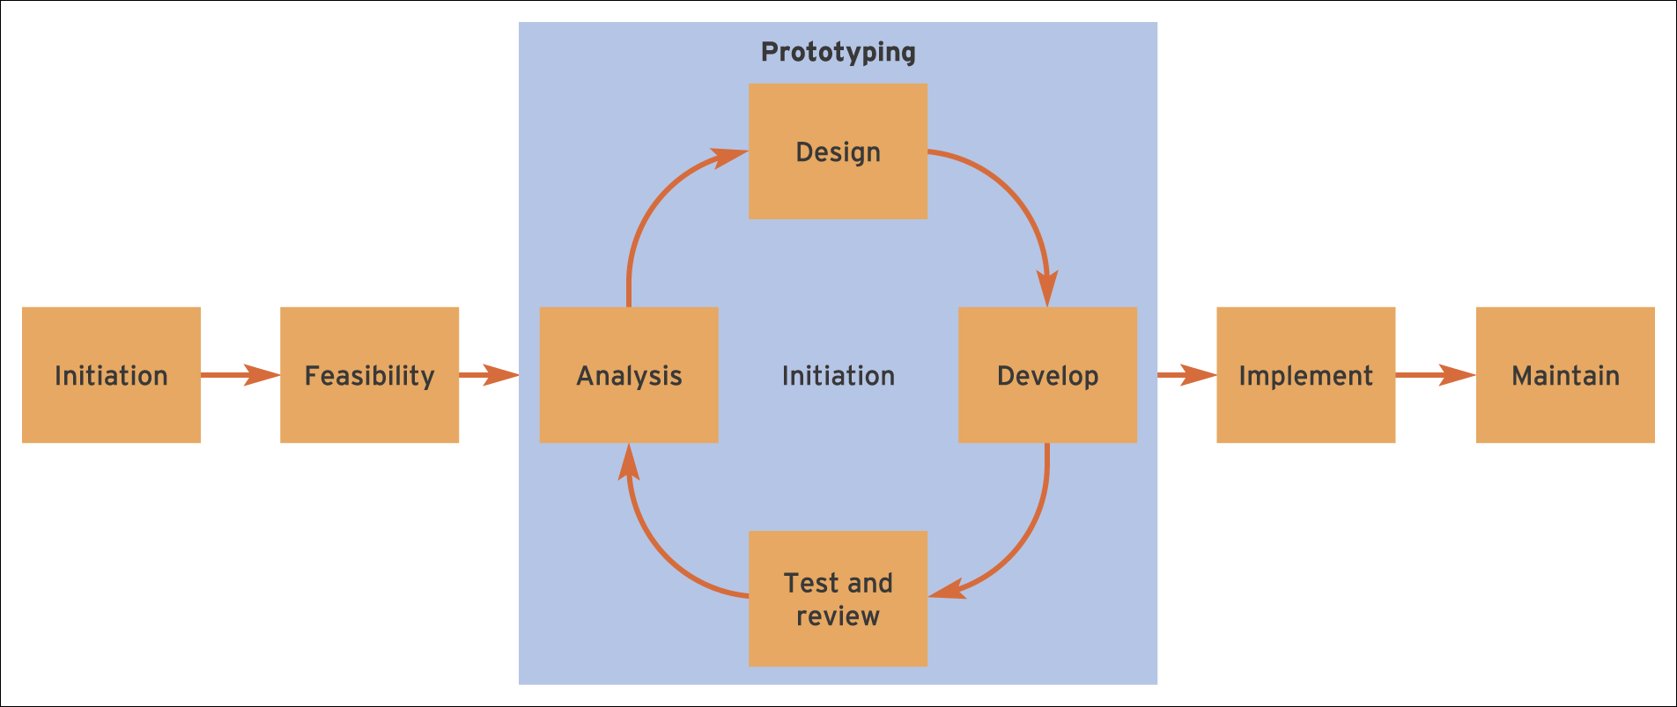
Figure 7.5 The role of prototyping within the systems development lifecycle

Slide 25
Spiral model
Spiral model: An iterative systems development in which the stages of analysis, design, code and review repeat as new features for the system are identified.
The four main activities of this model are as follows:
  Planning – setting project objectives, defining alternatives.
  Risk analysis – analysis of alternatives and the identification and solution of risks.
  Engineering – equivalent to the build phase of the SDLC with coding and testing.
  Customer evaluation – testing of the product by customers.

Slide 26
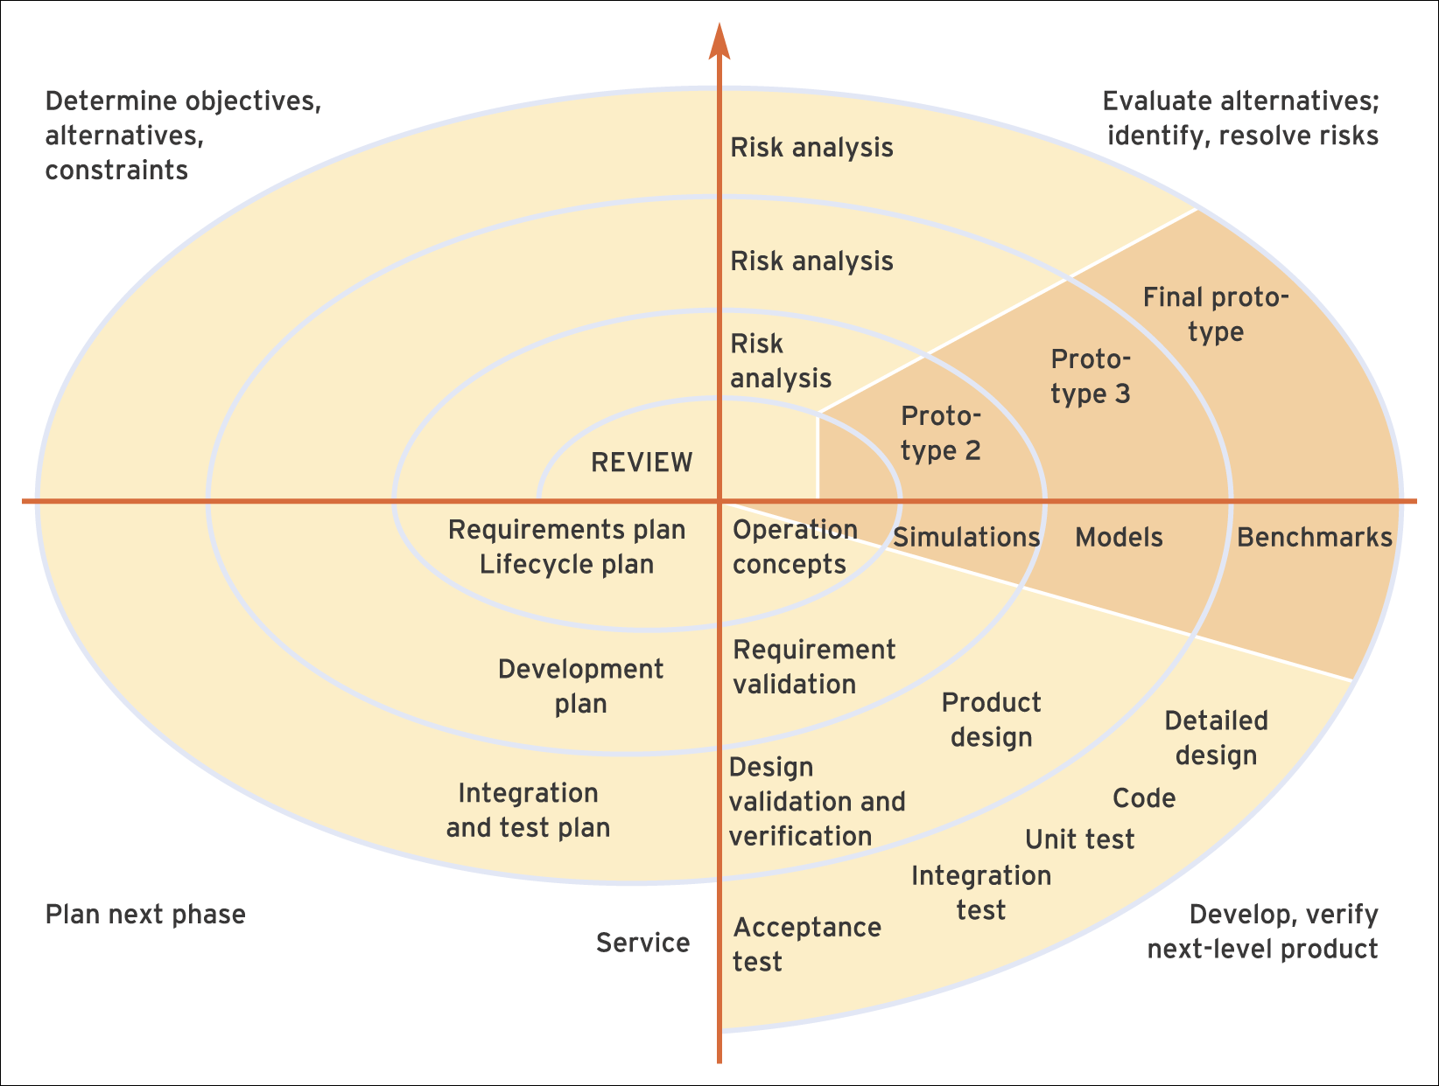
Figure 7.6 Boehm’s spiral model of systems development

Slide 27
Agile and lean software development
The lean approach to software development emphasises what is essentially an incremental approach to software development where software is developed and deployed in small and useful feature sets which work incrementally. This ‘feedback-driven’ approach to software development is in contrast to the traditional waterfall model where software development proceeds in a series of discreet steps, each of which should be completed before the next one can proceed.
Agile Software Development tends to relate more to the software engineering aspects of systems development. The term ‘Agile Methods’ has been around since 2001 and today encompasses a number of agile software development methods including Adaptive Software Development (ASD), Agile Unified Process (AUP), Scrum and Dynamic Systems Development Methodology (DSDM).

Slide 28
Dynamic Systems Development Methodology (DSDM)
Dynamic Systems Development Methodology (DSDM): A methodology that describes how RAD can be approached.
1. Active user involvement is imperative.
2. DSDM teams must be empowered to make decisions.
3. The focus is on frequent delivery of products.
4. Fitness for business purpose is the essential criterion for acceptance of deliverables.

Slide 29
Dynamic Systems Development Methodology (DSDM) (Continued)
5. Iterative and incremental development.
6. All changes during development are reversible.
7. Requirements are baselined at a high level.
8. Testing is integrated throughout the lifecycle.
9. A collaborative and co-operative approach between all stakeholders is essential.

